Slide 1



Build Interactive Web App with R & Shiny
Part 1 of ShinyApps series
Prepared by : Aep Hidayatuloh
Email : aephidayatuloh.mail@gmail.com
GitHub : https://github.com/aephidayatuloh
RPubs : https://rpubs.com/aephidayatuloh

Slide 2
Introduction

Slide 3

Welcome to Shiny!
Shiny is an R package that makes it easy to build interactive web applications (apps) straight from R.
i.e. for Entry data form, analytic dashboard, interactive demos for teaching statistics, etc.
The default styling of a Shiny application is clean and effective.
Very extensible and it is easy to integrate Shiny apps with your own web content using HTML and CSS.
JavaScript and jQuery can also be used to further extend the scope of Shiny apps.

Slide 4

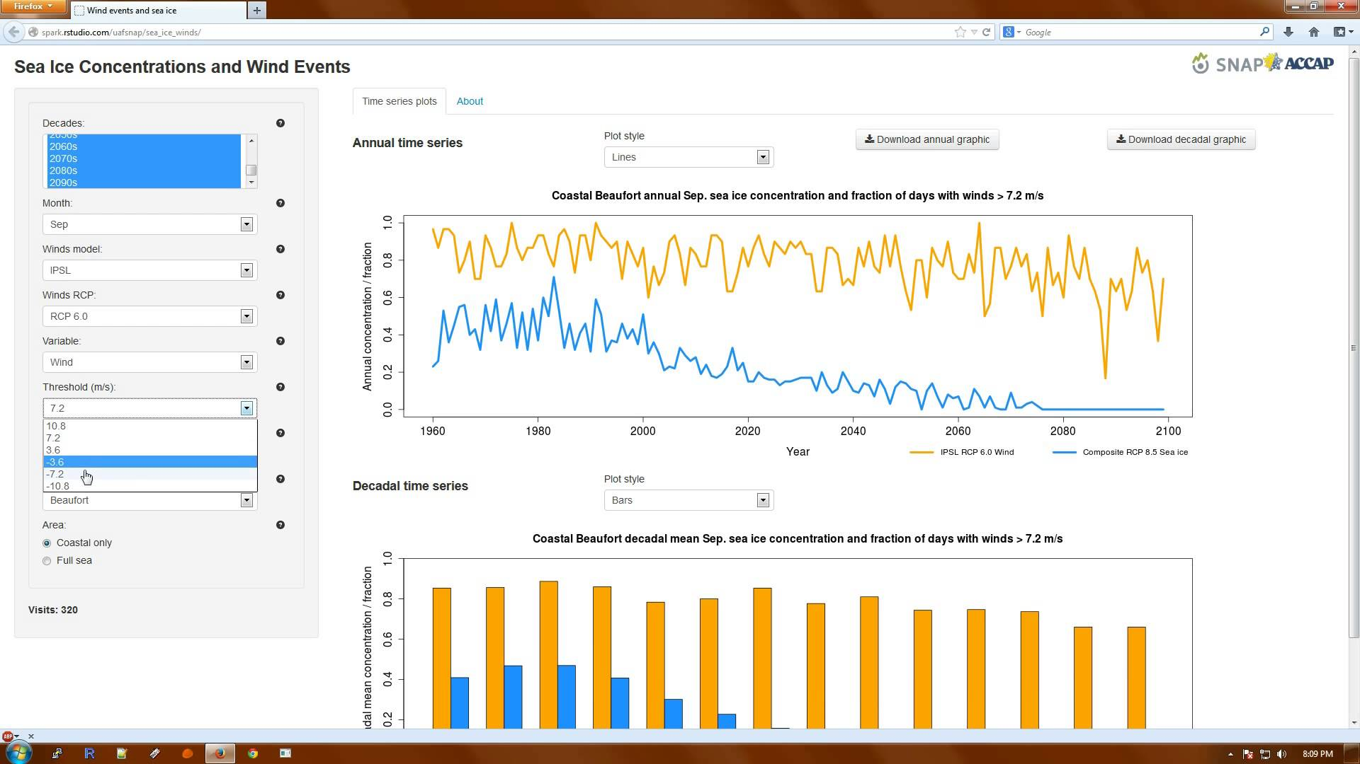
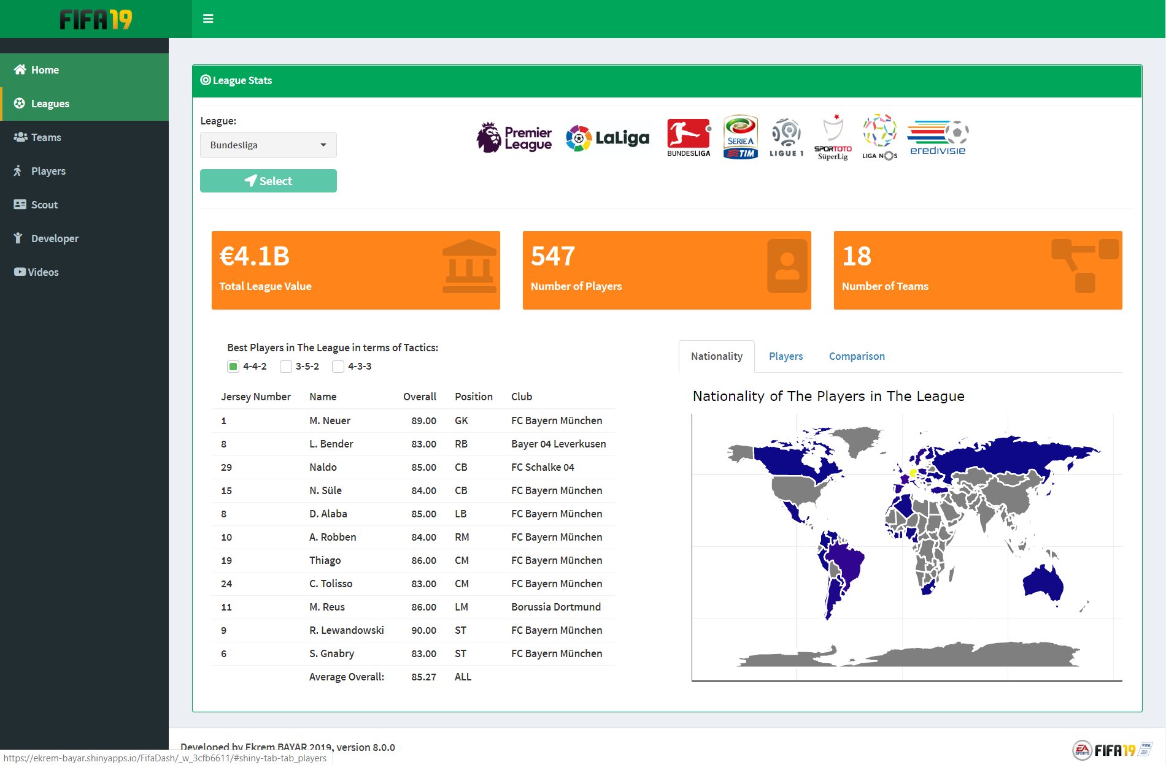
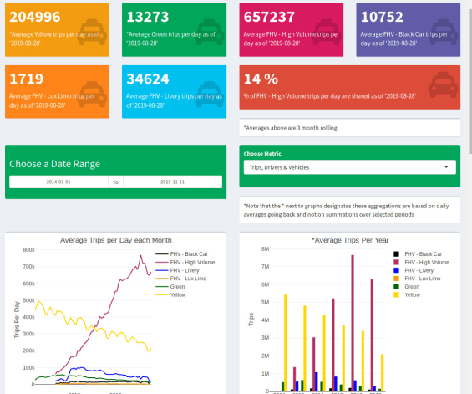
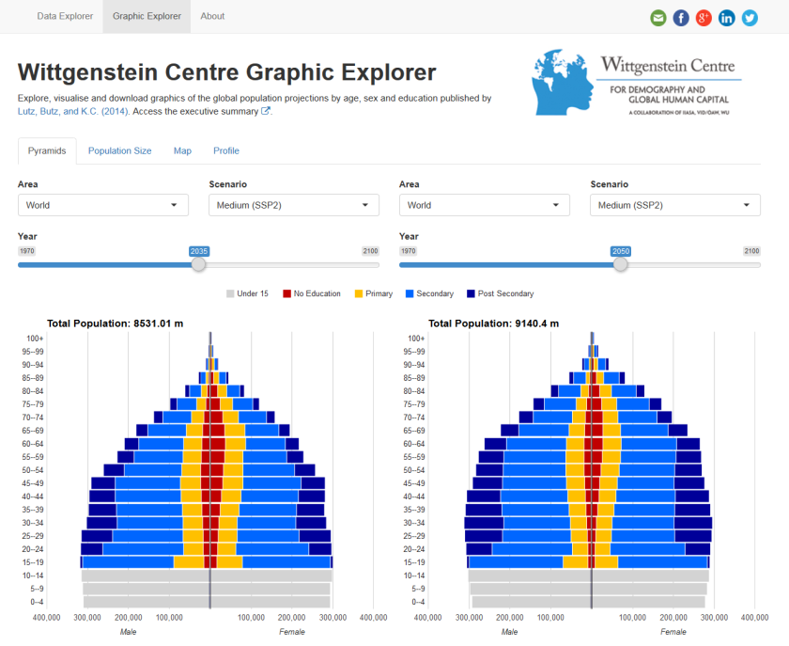
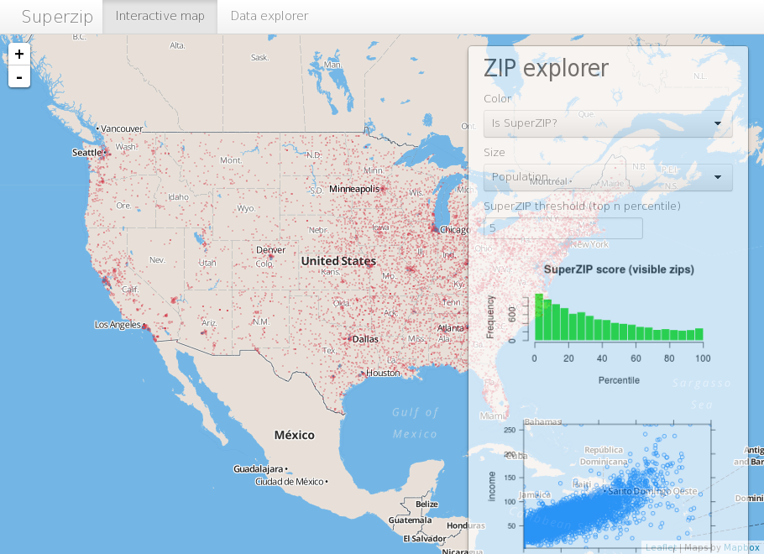
Shiny Apps

Slide 5

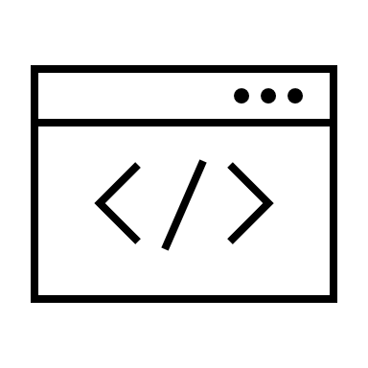
Requirement
Tools
Latest version of R program
Latest version of RStudio and shiny package
Browser (Mozilla Firefox, Google Chrome etc.)
Knowledge
R programming
Basic web knowledges

Slide 6
Lets Get Started!
Install R and RStudio
R : https://cran.r-project.org/
RStudio : https://www.rstudio.com/products/rstudio/download/
Install shiny package
# Install shiny package
install.packages("shiny")

Slide 7
Basic Shiny App
Layout And Structure Of Shiny

Slide 8
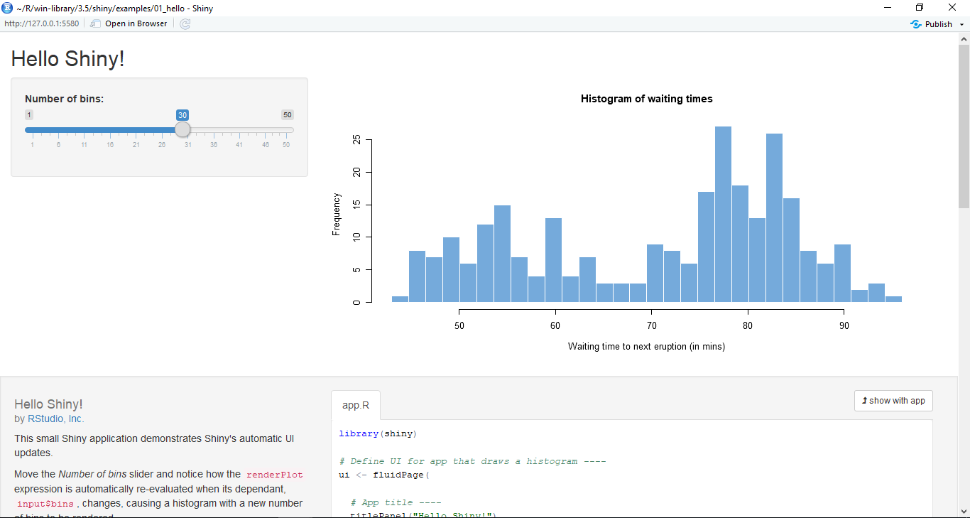
Hello Shiny!
# Example of shiny app
library(shiny)
runExample("01_hello")

Slide 9
Basic Shiny Apps
Layout
Title/Header Panel
Sidebar/Input Panel
Main/Output Panel

Slide 10
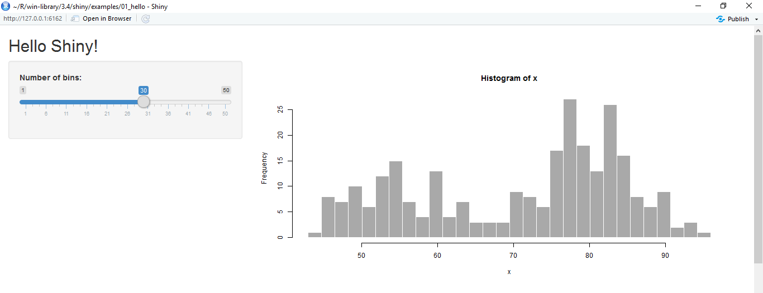
Basic Shiny Apps
Layout
Title/Header Panel
Sidebar/Input Panel
Main/Output Panel
You can create shiny apps with single file app.R or two files ui.R and server.R
ui
server
User Interface
Computation Processes

Slide 11
Shiny ui and server
ui
server
User Interface
Computation Processes
User Interface
Control the layout, appearance, widget for user inputs and display the output.
E.g. the title, page layout, text input, radio button, dropdown menu, graphics output etc.
Server
Set of instructions that uses the input provided by user, process them and produces the required output which is further displayed by ui.R

Slide 12
Shiny App Code – Single File
ui & server in a file named app.R
# file app.R
library(shiny)
ui <- fluidPage()
server <- function(input, output <, session>){}
shinyApp(ui, server)
<, session> means session argument is optional

Slide 13
Shiny App Code – Multiple File
ui & server in separated file named ui.R and server.R but in the same folder
# file ui.R
library(shiny)
shinyUI(fluidPage(
)
)
# file server.R
library(shiny)
shinyServer(function(input, output <, session>){
}
)

Slide 14
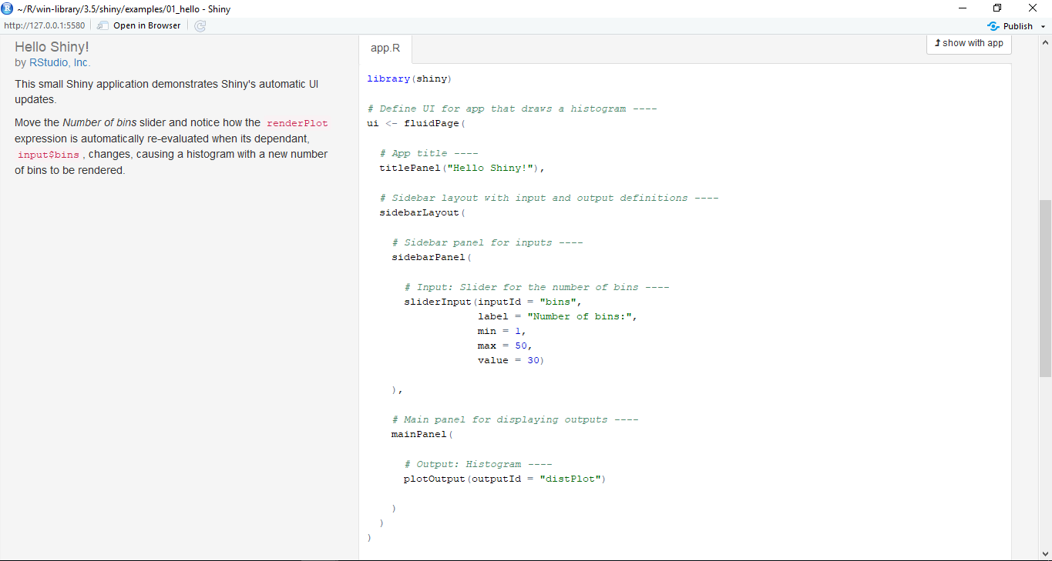
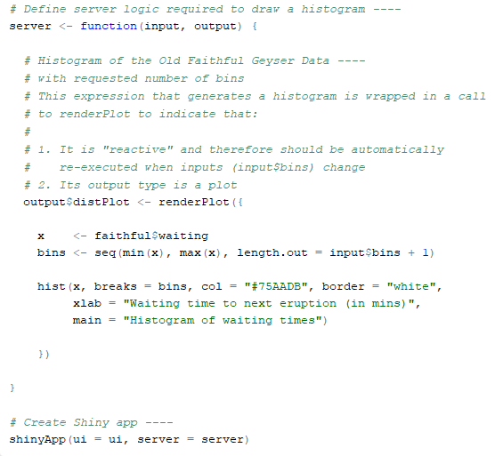
Inspect The App!
Single or Multiple file?

Slide 15
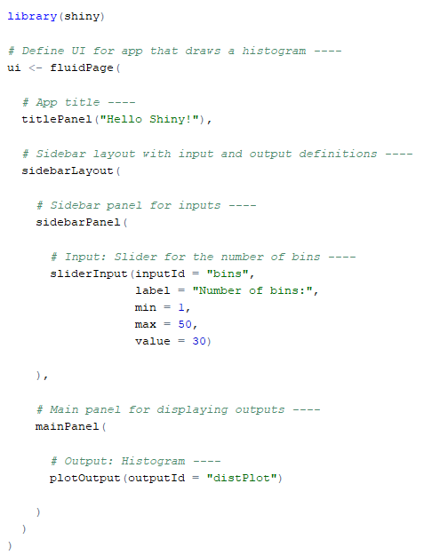
Inspect The App!
Load the shiny package
Define the UI
App’s title
Page with Sidebar Panel
Sidebar/Input Panel
Slider as interactive input
Main/Output Panel
Output from server

Slide 16
Inspect The App!
Define the Server
Comment in the
script using #
Create output with
output$<outputId>
Render the output (i.e histogram plot)
Read the input value
input$<inputId>
Create histogram
Run the app

Slide 17
Create Shiny App
Create Simple Shiny App

Slide 18


Programming is a skill best acquired by practice and example rather than from books.
-Alan Turing-

Slide 19

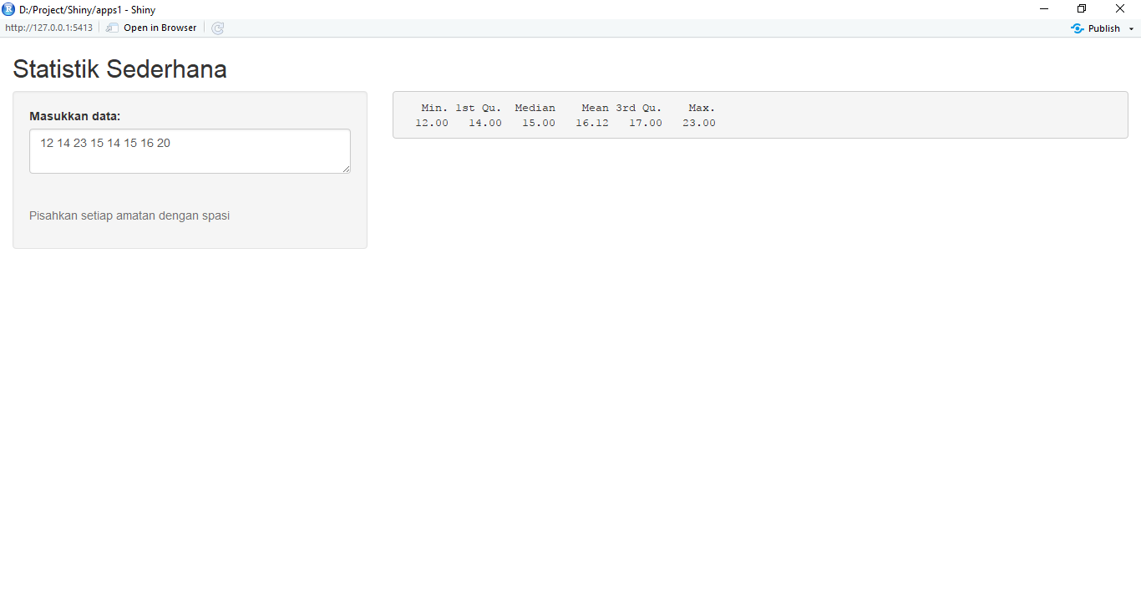
Example 1 Simple Statistical Descriptive
Create an single file app (app.R) and multiple file to display statistical descriptive from the typed data.
You can use textInput() or textAreaInput() as input field.
Split data by space, convert list object as vector using unlist() and convert as numeric vector with as.numeric() function.
Last, compute simple statistics with summary() function.
The app’s full code is available on http://bit.ly/STCExp1

Slide 20
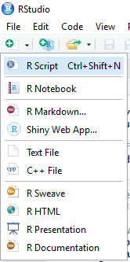
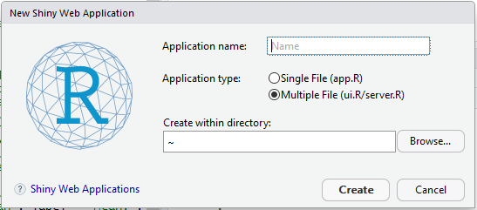
Using RStudio Menu
Create shiny apps template from RStudio
Provide Application name
Choose Single File (app.R) or
Multiple File (ui.R/server.R) for Application Type
Select folder for created shiny apps

Slide 21
Summary
We can create interactive apps for data visualization, i.e. dashboard, spatial maps etc, or data entry form.
Shiny apps is very extensible – HTML, CSS, JavaScript and JQuery.
Create Shiny Apps with UI and Server

Slide 22


